Slide 1

SMIT MEMON SOCIETY
MEDICAL CHATBOT
Supervisor
Sir Yasir Nawaz
Institution
Medical Chatbot that Analyzes Image & Text
SMIT, Memon Society Campus
Presented by
Ayan Ali
Junaid
Abdul Basit
Huzaifa
Umair Qureshi

Slide 2
Project Overview
Project Introduction
Intelligent Medical Chatbot
Medical chatbot application designed to analyze both medical images and user-provided text symptoms using cutting-edge Artificial Intelligence technologies.
Key Innovation
AI-Doctor demonstrates the practical application of multimodal AI in healthcare by seamlessly combining:
Advanced AI Architecture
Image Analysis
The system leverages a Large Language Model (Meta Llama-4 Scout 17B Instruct) through the GROQ API, combined with a FastAPI backend to process multimodal inputs efficiently.
Visual pattern recognition for medical conditions
Natural Language
Understanding symptom descriptions
Core Mission
Provide quick, AI-based medical guidance through an intuitive web interface, demonstrating how modern AI can assist in early medical understanding.

Slide 3
Goals & Objectives
Project Objectives
04
Multimodal AI Demonstration
Demonstrate the practical application of multimodal AI in healthcare assistance, showcasing how combined image and text understanding improves diagnostic accuracy.
01
Dual-Input Analysis Capability
Develop a medical chatbot that can simultaneously analyze both image uploads (skin conditions, wounds, rashes, medical reports) and text-based symptom descriptions for comprehensive assessment.
05
Universal Accessibility
02
FastAPI-LLM Integration
Make preliminary medical guidance accessible for users anytime, anywhere, reducing barriers to early health awareness and informed decision-making.
Successfully integrate FastAPI backend framework with a powerful Large Language Model using the GROQ API for high-performance, real-time medical inference.
03
Accessible Web Interface
Provide quick AI-based medical suggestions through a clean, intuitive web interface that requires no technical expertise to operate.
Impact Vision
By achieving these objectives, AI-Doctor aims to bridge the gap between advanced AI technology and practical healthcare assistance, making intelligent medical guidance available to everyone.

Slide 4
The Challenge
Problem Statement
Communication Barrier
Limited Access
Many people struggle to clearly describe their medical problems, leading to incomplete information and potential miscommunication with healthcare providers.
Doctors are not always available, especially in remote or underserved areas, creating significant healthcare access gaps.
Single-Modality Limitations
The Need
Diagnosis based on only image or only text is often inaccurate. A comprehensive understanding requires both visual and textual context.
There is a critical need for an AI system that can understand both medical images and symptoms text together for better preliminary guidance.

Slide 5
Our Solution
Proposed Solution
AI-Doctor: Intelligent Multimodal Medical Chatbot
Image Analysis
Analyzes uploaded medical images including skin conditions, wounds, rashes, and medical reports using advanced computer vision.
Quick & Accessible
Text Understanding
Provides instant medical guidance through an intuitive web application, making healthcare information accessible anytime, anywhere.
Reads and understands symptoms provided in text form, extracting key medical information and contextual details.
Combined Intelligence
Combines both image and text inputs to generate smart AI-based medical suggestions with comprehensive context.
Privacy First
Secure data handling

Slide 6
Research Foundation
Supporting Literature
Medical Image Analysis
Healthcare Chatbots
Extensive research demonstrates that AI models can accurately interpret skin conditions, wounds, rashes, and medical reports from images with high precision.
Applications of AI chatbots in healthcare have shown effectiveness in providing preliminary medical assistance, triage support, and patient education.
Large Language Models
API-AI Integration
Studies on LLMs demonstrate their ability to understand and generate human-like medical guidance from text symptoms and patient descriptions.
Integration of APIs with AI models (like GROQ with Llama models) enables real-time intelligent responses in web applications with low latency.
Multimodal AI Research
Project Inspiration
Research proves that combining image and text understanding significantly improves decision-making accuracy compared to single-modal approaches.
This project is inspired by recent developments in AI-powered healthcare assistants, multimodal learning, and LLM-based medical chat systems that demonstrate the transformative potential of AI in democratizing healthcare access.

Slide 7
Capabilities
System Features
Image Upload
Symptoms Input
AI Analysis
Upload medical images including skin issues, wounds, rashes, and medical reports for AI analysis
Enter detailed symptoms and medical history in text form to provide contextual information
Powered by advanced LLM technology for intelligent medical analysis and reasoning
Instant Response
Web Interface
Secure API
Get immediate AI-generated medical guidance without waiting for appointments
Clean, intuitive web-based interface accessible from any device with a browser
Secure API-based communication ensuring data privacy and protection

Slide 8
Tech Stack
Technologies Used
FastAPI
Jinja2
Backend API framework for high-performance async operations
Template rendering engine for dynamic HTML generation
PIL
Base64
Python Imaging Library for image processing and manipulation
Image encoding for API transmission and storage
GROQ API
Llama-4 Scout 17B
LLM communication interface for AI model access
AI reasoning model for medical analysis and response generation
HTML/CSS
Frontend UI development for responsive and interactive web interface

Slide 9
Architecture
System Architecture
Upload
Process
Encode
User
FastAPI
Base64
GROQ API
Generate
Display
LLM Analysis
Response
Webpage

Slide 10
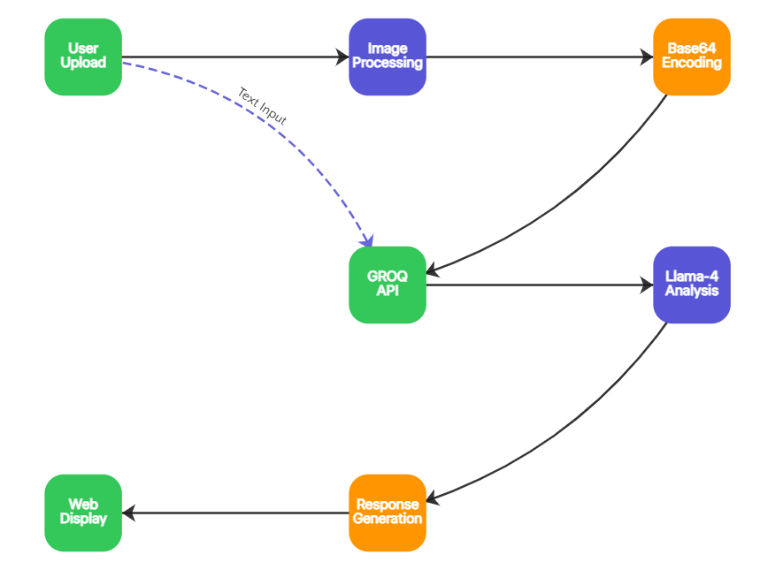
Workflow
Working Flowchart
1
Image Upload
User uploads medical image through web interface
2
Text Input
User enters symptoms and medical details
3
AI Processing
Image encoded & sent to Llama-4 for analysis
4
Response Display
Medical guidance displayed on webpage

Slide 11
AI Model
Role of Llama-4 Scout
17B Parameter Multimodal Model
Medical Context Understanding
The model comprehends complex medical terminology, symptoms, and visual patterns to provide contextually relevant analysis.
Instruction-Tuned
Fine-tuned for accuracy in medical reasoning and following specific instructions for healthcare applications.
Multimodal Fusion
Combines image and text understanding to generate comprehensive medical insights that consider both visual and descriptive data.
17B
Parameters
Multimodal
Human-like Responses
Model Capabilities
Generates natural, empathetic medical advice that is easy for users to understand and act upon.
Visual understanding
Text comprehension
Medical reasoning
Response generation

Slide 12
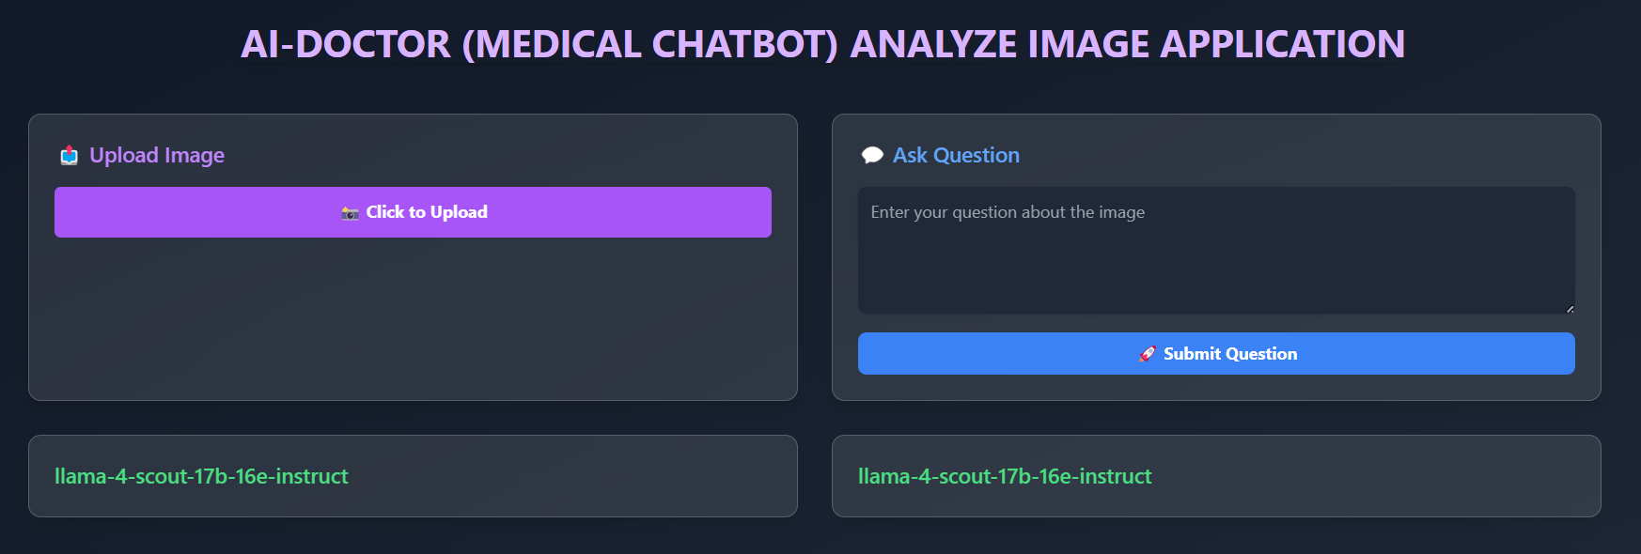
Frontend
User Interface
Image Upload
Text Input
Result Display
Simple drag-and-drop interface for uploading medical images with support for multiple formats
Clean text area for entering symptoms with placeholder guidance for users
Clear, formatted display section for AI-generated medical guidance and recommendations

Slide 13
Benefits
Advantages
Time Saving
Remote Access
Provides quick initial medical guidance without waiting for appointments, reducing time to get preliminary healthcare information.
Helpful in remote areas with limited healthcare access, bringing medical guidance to underserved communities.
Early Guidance
Multimodal AI
Enables timely preliminary medical assessment, helping users understand when to seek professional care.
Combines image and text analysis for comprehensive understanding, providing more accurate guidance than single-modality systems.

Slide 14
Roadmap
Future Enhancements
Voice Input
PDF Analysis
Chat History
Enable voice-based symptom description for improved accessibility and ease of use
Medical report PDF upload and analysis for comprehensive health record understanding
Store and retrieve past conversations for tracking medical queries over time
Database Integration
Multi-Language Support
Persistent storage for user profiles, medical history, and analysis results
Expand accessibility by supporting multiple languages for global healthcare reach, enabling users from different regions to interact with the system in their native language

Slide 15
CONCLUSION
AI-Doctor represents the future of
accessible healthcare
By combining cutting-edge LLM technology with advanced image analysis, AI-Doctor demonstrates the transformative potential of multimodal AI in providing intelligent medical guidance using both visual and textual inputs.
AI-Powered
Multimodal
Accessible
Llama-4 Scout Model
Image + Text Analysis
Web-Based Platform

Slide 16
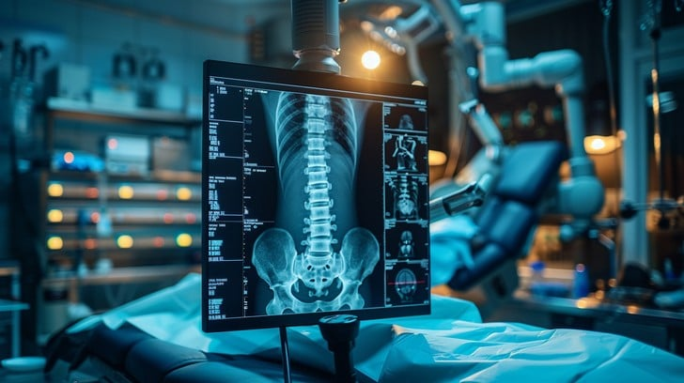
Thank You

